Slide 1

Sustainability Study of McAdam Elementary School

Slide 2
Public Meeting #1 Agenda
Introductions
Review of Provincial Policy 409 Multi – Year School Infrastructure Planning
Presentation of Facts – McAdam Elementary School
Question and Answer
What’s Next?
  Online Resources and Feedback
  Next Meetings

Slide 3
Provincial Policy 409: Multi-year School Infrastructure Planning
Outlines a number of responsibilities to do with facilities in our system
Sections 6.4, 6.5 and 6.6 are relevant for Sustainability Studies
Three Public Meetings
  Meeting 1 – Presentation of Facts from District regarding School (Policy 409, 6.4.4 )
  Meeting 2 - Presentation from Stakeholders regarding their thoughts on the sustainability of the school and relevant factors
  Meeting 3 – Final Review of Information by District Education Council (DEC) and subsequent motion on next steps
Not Designed as an “Us-Against-Them” process; public meetings are not designed to facilitate debate between two parties
Three Possible Outcomes
  Status Quo
  Recommendation to Minister to repair the school
  Recommendation to Minister for closure, moving the students elsewhere

Slide 4
Presentations of Facts
Enrolment
Quality of Education Programs & Services
Provincial Assessment Results & Student Perception Results
Health & Safety Building Assessment
Transportation
Finances
Impact on Other Schools
Economic Development
Impact on the Local Community

Slide 5
Enrolment McAdam Elementary School

Slide 6
Enrolment By Grade Level: McAdam Elementary School
 | 2008 | 2009 | 2010 | 2011 | 2012 | 2013 | 2014 | 2015 Projected
K | 14 | 14 | 11 | 10 | 12 | 16 | 10 | 18
1 | 15 | 14 | 12 | 10 | 9 | 13 | 10 | 10
2 | 16 | 16 | 15 | 13 | 10 | 7 | 12 | 9
3 | 14 | 18 | 16 | 14 | 12 | 10 | 9 | 10
4 | 13 | 12 | 18 | 16 | 14 | 12 | 11 | 8
5 | 19 | 13 | 15 | 17 | 15 | 13 | 12 | 9
Total | 91 | 87 | 87 | 80 | 72 | 71 | 64 | 64
Notes:
K - 2008 -13 -1
K -2009-2014 -2
K- 2010-2015 -2
1 -2008 -2012 -2
1- 2009 -2013 –1
1- 2010- 2014 – 0
1- 2011-2015 - -1

Slide 7
Projected Enrolment McAdam Elementary

Slide 8
Functional Capacity
Functional Capacity Data | Student Enrollment | Number of Classrooms | Classrooms in Use | School Capacity | Capacity Rating
Based on 24 Students per class | 64 | 8 | 5 | 192 | 33.3%

Slide 9
Quality of Education Programs and Services
Educational Staff
The provincial staffing formula calls for:
Student Teacher Ratio McAdam Elementary School
Full Time Equivalent (FTE) 2015-16 | McAdam Elementary School
Classroom Teachers | 5.50 FTE
Administration | 0.50 FTE
Guidance | 0.00 FTE
Resource | 0.40 FTE
Other | 0.20 FTE
Total | 6.60 FTE
Year | Total Number Student : Ratio | Student : Teacher
2014-15 | 64 : 6.80 | 9.41 : 1
2015-16 | 64 : 6.60 | 9.69 : 1
Notes:
Remember this is 2015-16 staffing.

Slide 10
Support Staff Information
Full Time Equivalent (FTE) 2015-16 | McAdam Elementary School
Educational Assistants | 3.0 FTE
Administrative Assistant | 36.25 hours per week (1.0 FTE)
School Library Worker 1 | 3.25 hours per week ( 0.09 FTE)
Custodian II | 40 hours per week (1.0 FTE)
Custodian I | 15 hours per week ( 0.37 FTE)
Notes:
Remember this is 2015-16 staffing.

Slide 11
McAdam Elementary School
Student : Teacher Ratio 2014-15
School | Year | Total Number Student: Teacher | Student: Teacher
McAdam Elementary | 2014 - 2015 | 64 : 6.80 | 9.41 : 1
Chipman Elementary | 2014 - 2015 | 104 : 8.00 | 13.00 : 1
Lincoln Elementary | 2014 - 2015 | 171 : 13:5 | 12.67 : 1
Nackawic Elementary | 2014 - 2015 | 221 : 14.5 | 15.24: 1

Slide 12
Class Size Comparisons 2014-2015
 | Minimum Class Size | Maximum Class Size | Average Class Size | Number of Classes 2014-15 | Number of Classes 2015-16
McAdam Elementary School | 11 | 15 | 13 | 5 | Minimum class size - 9 Maximum class size - 18 Average class size - 13 5
Lincoln Elementary School | 13 | 21 | 17 | 10 | 10
Chipman Elementary School | 14 | 21 | 17 | 6 | 7
Nackawic Elementary School | 15 | 25 | 20 | 11 | 12

Slide 13
Maximum class sizes
Grade Level | Maximum Number of Students
K-2 | 21
3 | 26
K-3 Combined Classes | 16
Grades 4-6 | 28
Grades 3 -5 Combined Classes | 23
Grades 7 to 12 | 29
Grades 5 to 12 Combined Classes | 24

Slide 14
Core Curriculum
 | Early French Immersion | Late French Immersion | Gymnasium | Music/Fine Arts Specialists | Educational Support Services | EST-Literacy | EST-Math | EST-Technology
McAdam Elementary School | No | NA | Yes | No | Yes | Yes | Yes | Request Support
 | EST-French ImmersionI | EST Science | Science Labs | Computer Lab | Computer Aided Drafted Lab (CAD) | Middle Level Technology | Broad Based Technology | Skills Trade Area | Distance Learning
McAdam Elementary School | No | Yes | No | Yes | NA | NA | NA | NA | NA

Slide 15
Quality of Education
Programs and Service
Grade 5 students from McAdam Elementary School enter McAdam High School for Prime Programs beginning in Grade 6.

Slide 16
Impact on Other Schools
Beyond a decision of status quo or a recommendation to fix/upgrade the school as it stands now, the following scenarios rise to the surface as possible considerations:
Movement of students from McAdam Elementary School to Harvey Elementary School.
Movement of students from McAdam Elementary School to a newly created K-12 setting at the current McAdam High School.

Slide 17
Two Scenarios
 | K-5 at Harvey Elementary School | K-12 at McAdam High School
Projected 2016-17 enrolment | 248 | 165
Projected 2016-17 number of homerooms | 12 | 7 Homerooms ( K-8 ) + 62 High School Students
Projected 2016-17 Functional Capacity | 93.9% | 48.8%
Projected 2016-17 Teacher FTE | 16.0 FTE | 14.7 FTE

Slide 18
Special Events That Encourage Community
School Partnerships at McAdam Elementary
Town Library Program
Fire Safety Presentation with Firefighters
IWK Coins For Kids
Partnership with Co-op Students from McAdam High School
Literacy Week Guest Readers
Manor Visits at Christmas and in the Spring
For a complete listing of community school partnerships please view the schools annual reports posted on the ASD-W sustainability site at www.asd-w.nbed.nb.ca and follow the sustainability links.

Slide 19
Student Voice
Tell Them From Me Survey
Student Leaders support in the planning and leading during Winter Fun Week and Spring Fun Day activities
Students are involved in the creation of classroom expectations across the school
Students involved in updates/discussion around school mission, vision and the school motto
For a complete listing of opportunities for student voice please view the schools annual reports posted on the ASD-W sustainability site at www.asd-w.nbed.nb.ca and follow the sustainability links.

Slide 20
Provincial Assessment Results
    Grade 2 Reading
    McAdam Elementary School
    Grade 4 Reading
    McAdam Elementary School
Year | McAdam Elementary | District | Province
2009-10 | 73.3% | 72.5% | 83.6%
2010-11 | 69.3% | 75.8% | 80.3%
2011-12 | 76.9% | 78.0% | 79.1%
2012-13 | 81.8% | 80.3% | 79.5%
2013-14 | 55.6% | 76.8% | 77.5%
Year | McAdam Elementary | District | Province
2009-10 | 71.4% | 78.4% | 83.4%
2010-11 | 70.6% | 74.3% | 80.5%
2011-12 | 68.8% | 77.5% | 77.1%
Results not available after 2011-12 due to changes in the Provincial Assessment system.

Slide 21
Provincial Assessment Results
Grade 5 Numeracy McAdam Elementary School
Year | McAdam Elementary | District | Province
2009-10 | 100.0% | 54.3% | 59.4%
2010-11 | 85.7% | 60.4% | 60.8%
2011-12 | 100.0% | 63.7% | 63.7%
2012-13 | 100.0% | 64.0% | 62.9%
*2013-14 | NA | 60.0% * | 59.4% *
* Based on a 20% sample of students.

Slide 22
Student Perception Data
Based on the 2014-15 Student Perception Survey Results Grades 4-5
62% of students reported that they feel accepted and valued by peers and others in the building, contributing to a positive sense of belonging. * Canadian norm is 86%.
68% of students reported that they feel safe attending their school. * Canadian norm is 69%.
100% of students reported that they value school outcomes and the importance of education to their future. Canadian norm is 96%.
68% of students reported that they were interested and motivated in their learning. * Canadian norm is 74%.
For a complete review of the school based Tell Them From Me Reports please visit the ASD-W sustainability site at www.asd-w.nbed.nb.ca and follow the sustainability links.

Slide 23
School Benefits
Strong knowledge of individual students, as well as their strengths and needs.
All students are active participants in school wide initiatives.
Smaller class settings create an opportunity for staff to provide one on one attention more readily and allow for an emphasis to be placed on pro-social behaviours throughout the school community.
A culture of collaboration is established among staff.
Staff, parents and students have developed a strong community culture within the school.

Slide 24
School Challenges
Staff in positions of responsibility are often required to teach specialty subjects and have a large percentage of time dedicated to teaching.
Teacher teaming opportunities are sometimes challenging due to teacher schedules and supervision schedules. This is in large part due to a small number of teaching staff. Funding for educational staff is based on student enrolment.

Slide 25
McAdam Building Summary
McAdam Elementary was constructed in 1945.
An addition was built and extensive renovations were completed in 1982.
The renovations in 1982 included:
  New electric boiler
  New ventilation system

Slide 26
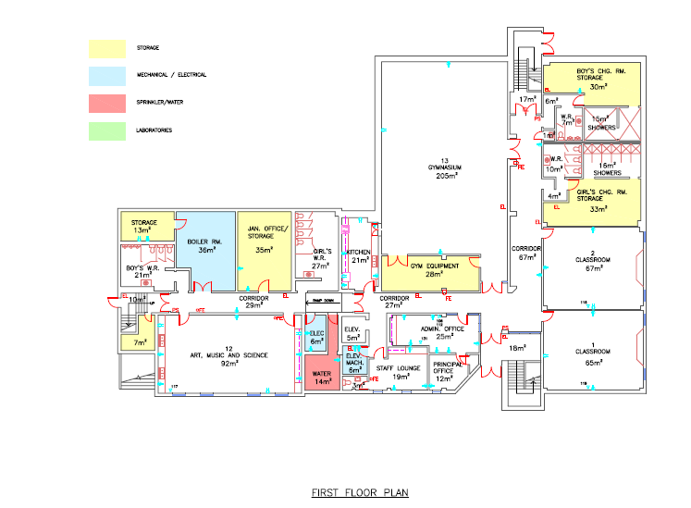
McAdam Elementary School Bottom Floor

Slide 27
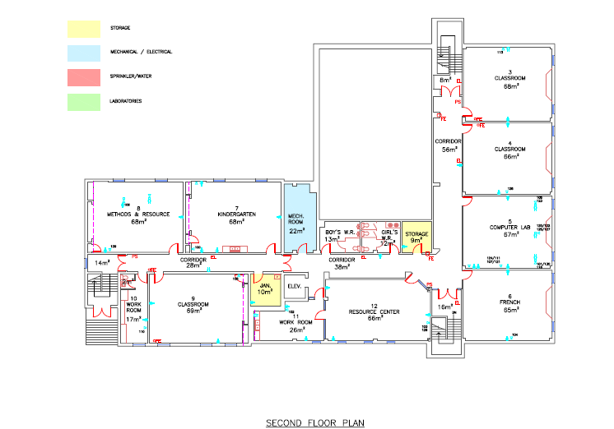
McAdam Elementary School Top Floor

Slide 28
McAdam Elementary School Building Condition
Exterior building brick walls are in good condition. Windows and doors are generally in good condition. One of the three main roofs is original and is recommended to be recapped.
Flooring in the corridors and three classrooms is vinyl tile and in good condition. The remainder of the classrooms have carpeting.
Interior walls are constructed of concrete block and in good condition.

Slide 29
McAdam Elementary School
Building Systems
The school has a public address system.
The school is heated by an electric boiler.
Mechanical ventilation was installed in 1982.
The heating is controlled by the thermostats in the individual classrooms, a controls upgrade is to be considered.
Water and sewage is provided by the Village.

Slide 30
McAdam Elementary Interior
Stairways are enclosed to meet fire separation requirements complete with fire rated doors; classroom doors are fire rated as well.
Building is equipped with a fire alarm system and fire extinguishers are located throughout the building.
The building has an elevator, there are barrier-free washrooms on both first and second floors.

Slide 31
McAdam Elementary Exterior
The parking lot is separated from the bus zone area.
The parking lot is in fair condition with a few cracks and potholes and is to be considered for asphalt replacement.

Slide 32
McAdam Elementary School
Capital Investments
Year | Scope of Work | Cost
2000 | Heating and Ventilation maintenance | $15,000
2004 | Roof replacement | $95,003

Slide 33
McAdam Elementary School
Physical Plant Status
Building Exterior and Site |  | Description | Estimated Cost
Site | Parking Lot | Repaving
Site | Walkways | Repair Walkways
Building Envelope | Roof | Recap roof #4
Building Envelope | Exterior Walls | Masonry Repairs
Building Envelope | Exterior Doors | One set frequently needs maintenance and is to be considered for replacement

Slide 34
School Physical Plant Status (continued)
Building Mechanical and Electrical |  | Description | Estimated Cost
Heating and Ventilation | Heating System | Replace boiler
Heating and Ventilation | Thermostat and Controls | Controls System Upgrade
Electrical | Electrical Maintenance | Switchgear Cleaning and Repair
Electrical | Electrical Receptacles | Install three new receptacles in each classroom

Slide 35
School Physical Plant Status (continued)
Building Interior |  | Description | Estimated Cost
Interior | Flooring | Replace carpet with vinyl tile.
Interior | Classrooms | Classroom Upgrade
 |  | Total: | $456,500

Slide 36
McAdam Transportation Study
Currently students in grades K-12 that reside in the McAdam Schools Catchment area are bused to the McAdam Elementary and High Schools.
The morning school bus system currently sees one bus transport students within the McAdam Schools Catchment area into the McAdam Elementary and High Schools on two separate routes.
A number of years ago there was a change in the catchment area boundaries that redirected a number of students from McAdam to Harvey.

Slide 37
McAdam Transportation Study
The afternoon school bus system currently sees one bus transport students residing within the McAdam Schools Catchment area on two separate routes (K–2 & 3-12).
There would not be any impact with regards to the number of school buses or drivers if the McAdam Elementary School should close and the students were to go to McAdam High School.
There would be increased transportation costs and time on bus for students if the McAdam Elementary School should close and the students were to go to Harvey Elementary School.

Slide 38
McAdam Transportation Study
School | Longest Ride In | Longest Ride Out | Earliest Pick-up | Latest Drop Off | Average Ride Time
McAdam Elementary School | 23 mins | 40 mins | 7:42a.m. | 3:40p.m. | 9 mins
McAdam High School | 19 mins | 43 mins | 7:41a.m. | 3:44p.m. | 13 mins

Slide 39
Current Student Address Distances
 | Distance to McAdam Elementary School (KM) | Distance to McAdam High School (KM) | Distance to Harvey Elementary School (KM) (Scenario)
Average Distance | 1.5 | 1.2 | 33.4 (Average travel time 40 minutes)
Maximum Distance | 10.3 | 10.6 | 42.7 (Maximum travel time 50 minutes)
Minimum Distance | 0.1 | 0.1 | 30.5 (Minimum travel time 35 minutes)

Slide 40
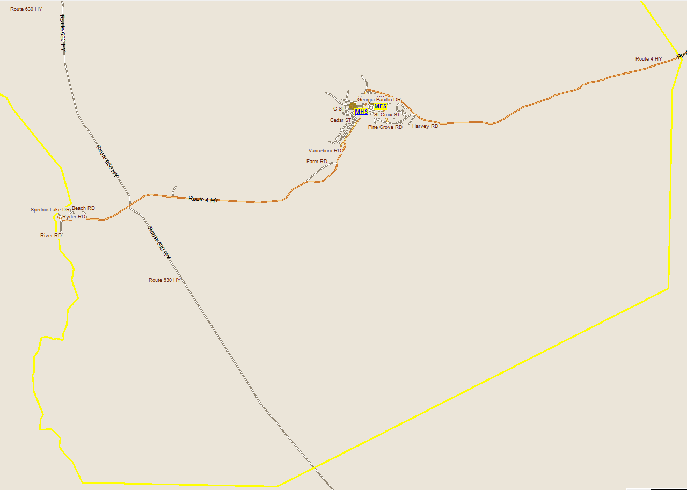
McAdam Transportation Study

Slide 41
McAdam Elementary School Salaries
 | Actual Costs
Cost Centers | Fiscal Year | Fiscal Year | Fiscal Year
 | 2014-2015 | 2013-2014 | 2012-2013
Salaries
Administration | 9,803 | 11,578 | 12,542
Teacher | 447,197 | 465,956 | 497,100
Admin. Assistant | 31,780 | 30,959 | 30,194
Educational Assistant | 50,974 | 56,811 | 49,988
Custodian | 60,596 | 60,289 | 58,510
Total | 600,350 | 625,593 | 648,334

Slide 42
Assigned Budgets
 | Actual Costs
Cost Centers | Fiscal Year | Fiscal Year | Fiscal Year
 | 2014-2015 | 2013-2014 | 2012-2013
Assigned Budgets
Regular Instruction | 10,174 | 10,442 | 13,357
Admin.Support | 2,510 | 2,576 | 2,748
Library | - | - | -
Teachers Working Conditions | 1,772 | 1,873 | 2,657
Nutrition | 659 | 672 | 500
Bilingual Learning Environ. | 300 | - | 300
Wellness Grant | 1,228 | 475 | 482
Co/Extra Trips | 529 | 542 | 578
PSSC | 214 | 215 | 434
Total | 17,386 | 16,795 | 21,056

Slide 43
Facilities Costs
 | Actual Costs
Cost Centers | Fiscal Year | Fiscal Year | Fiscal Year
 | 2014-2015 | 2013-2014 | 2012-2013
Facilities Costs
Electricity | 36,161 | 35,666 | 32,985
Water and Sewer | 6,904 | 6,570 | 3,250
Garbage Removal | 1,568 | 1,581 | 1,790
Ground Maintenance | 6,069 | 5,767 | 5,567
Cleaning Supplies | 1,846 | 1,334 | 1,350
Minor Repairs | 5,146 | 7,512 | 3,209
Total | 57,694 | 58,430 | 48,151

Slide 44
Total Costs
 | Actual Costs
Cost Centers | Fiscal Year | Fiscal Year | Fiscal Year
 | 2014-2015 | 2013-2014 | 2012-2013
TOTAL COSTS | 675,430 | 700,818 | 717,541

Slide 45

Village of McAdam
Economic Development
Submitted by McAdam Village Council – October, 2015
The Village of McAdam states that the economic development of a community relies on a solid foundation of citizens. These citizens require four pillars to sustain their community:
Health
Education
Justice
Citizen Wellness

Slide 46

Village of McAdam
Economic Development
Employment Stats:
Company | Jobs | Trends
Certainteed | 48 | Steady Volumes, Little Fluctuations
Soleno Inc. | 29 + 8 indirect | Stable Employment Level
Wauklehegan Manor Inc. | 75 + Several Local Service Providers | The need for services for seniors is on the rise.
McKay’s Garage Ltd | 24 | Business growth continues
The Gun Dealer & Faulkner’s Dept. Store | 16 + 1 indirect | Interact Sales Stronger New Supreme Gas Pumps being added
Canada Border Services St. Croix | 14 | Not Applicable
Total | 215

Slide 47
Village of McAdam
Economic Development
A Significant Number of Jobs (5 or more) are provided at:
Lakeland Industries
Granite Industries
N.B. Southern Railway
McAdam Independent Grocery
McAdam PharmaChoice
Home Concepts
M&R Plourde Logging
G. W. MacKay, Ltd.
Scotiabank
Over the past year the community has seen the closure of the McAdam Branch of the Credit Union and the Service New Brunswick Office (3 days a week service).

Slide 48
Village of McAdam
Economic Development
Other Businesses and Services:
Store Front Businesses: 22
Home Operated Businesses: 14
Seasonal Businesses: 6
Service Providers: 14
  The Resource Centre/Food Bank
  Harris’ Redemption Centre
  McAdam Health Centre
  McAdam Lions’ Club
  McAdam Outreach Program
  McAdam Post Office
  McAdam Public Library
  McAdam Recreation Department
  McAdam Detachment-RCMP
  Royal Canadian Legion – Branch 7
  McAdam Lions Community News
  Village of McAdam
  McAdam Schools
  Ambulance New Brunswick

Slide 49
Village of McAdam
Economic Development
McAdam is open for business and welcomes entrepreneurs and citizens to share life’s experiences in the “Best Little Village in New Brunswick”.
A new Industrial Site featuring 55 Acres of prime space adjacent to rail transportation.
Housing is available in the Village. Real Estate is attractively priced. Ninety acres of residential and commercial land is available.
New Housing Starts in 2013 – 3, 2014 – 3, and thus far in 2015 – 4
Number of persons/families moving to the area (McAdam-St. Croix) in
  May to December – 2014 - 6
  January to date – 2015 - 8
Tourism has grown by more than 300% over the past 3 years.
2011 – 4,355 visitors
2012 – 15,424 visitors
2013 – 16,139 visitors
2014 – 17,807 visitors
2015 to Date – 19, 711
From 2011 to 2014 that’s an increase of 308% and figures for 2015 indicate an 11% increase over 2014.

Slide 50
Village of McAdam
Economic Development
Projects and Initiatives over the next 2 – 3 years include:
Restoration of the 2nd Floor of the McAdam Railway Station creating Hotel Rooms, expanded operations and the creation of many additional jobs.
Establishing a Community Residence by the McAdam Heart and Home Corporation.
Participating in a Regional Development Strategy to boost residency and opportunities and employment in Southwestern NB.
The return of McAdam’s work force and families from Western Canada. There are at present 65 Wage Earners and 13 family members from McAdam living in Western Canada.
The NB Premier’s New Job Announcement for Southwest NB includes McAdam.

Slide 51
Village of McAdam
Economic Development
In 2013, the McAdam Community Action Committee comprised of several citizens from both within and outside the Village as well as Municipal Council was established. A team of volunteers, second to none, understands its role to provide opportunity and sustainability by promoting, initiating, and partnering to create actions that will lead to growth and development.
To date, these include:
  Revitalization of special events to attract new citizens and visitors, including formation of a Welcoming Committee and the development of a Guide Book to Community Services,
  An extensive Beautification Plan for the Village.
  Several ‘Shop McAdam’ Promotional Campaigns.
  McAdam Heart & Home Corporation established.
  Campaign to encourage growth and development

Slide 52
Village of McAdam
Economic Development
McAdam offers close proximity to nature to promote quality of life and attract tourists and new migrants, especially along the border with the United States. McAdam offers the beauty of the land and people (The mighty Heritage St. Croix River; the pristine Spednic Lake and a National/Provincial treasure---The McAdam Railway Station)
And
A Safe Community that offers just about every service and meets the needs of those who call it home.

Slide 53
Impact on the Community of McAdam
Community currently enjoys two educational facilities which naturally separates elementary from middle and high school students. Grade configurations in schools may have an impact on family perception of quality education; would this result in relocation?
Close community ties between the schools and local service groups.
Slight loss in employment opportunities within the school system within the village.
Future of vacant building would be unknown and could have a positive or negative impact on the community.
Public meeting # 2 will explore this impact further, as experts and stakeholders from the community share their thoughts .

Slide 54
McAdam Elementary School Sustainability Study – Visit our Website for Details!
  Sustainability Study Timeline
  Minister Letters
  Parent Letters
  McAdam Elementary School at a Glance
  Link to Policy 409
  Public Meeting #1 – Presentation
  www.asd-w.nbed.nb.ca
Feedback can be given
  via email at asdwsustainability@nbed.nb.ca
  through our discussion board at the McAdam Elementary School Sustainability Study site on our webpage
  mail to Carol Clark-Caterini, Anglophone West School District, 1135 Prospect Street, Fredericton, NB E3B-3B9
Notes:
Reminder of what “sustainability” means:
Maintain the status-quo
Invest dollars into the infrastructure/programming
Close and move the students to another school for their continued education

Slide 55

Questions and Answers

Slide 56
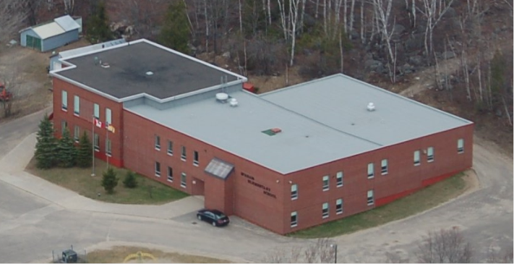
Thank you for coming!

